Slide 1
Project 3 Ethical Hacking
By: Jacob Nava

Slide 2
Executive Summary
After successfully installing a network upgrade for my company’s client, I have been asked to perform another cybersecurity service for that client.
The client hired me as a consultant to install and configure a new server in their internal network to support production and operations.
I was also tasked with determining the vulnerabilities of the new Production server and provide specific examples of how any vulnerabilities could be exploited as well as perform the same service on the Webserver in their DMZ.

Slide 3
Tasks Performed
Install the supplied Production server VM into the Trusted network in VirtualBox
Used tools within Kali Linux to enumerate all vulnerabilities on the Production server. Researched the severity of the vulnerabilities using their CVE numbers
Used tools within Kali Linux to enumerate all vulnerabilities on the Web server. Researched the severity of the vulnerabilities using their CVE numbers
Exploited at least 2 of the vulnerabilities I found on the Production server, giving me root access to the server
Exploited at least 2 of the vulnerabilities I found on the Web server, giving me root access to the server.
Created my own “backdoor” account on the Production server that has root permissions
Looked for any interesting files on the Production and Web servers
Bonus: crack the passwords for the users configured on the Production server
Provide recommendations to improve server security

Slide 4
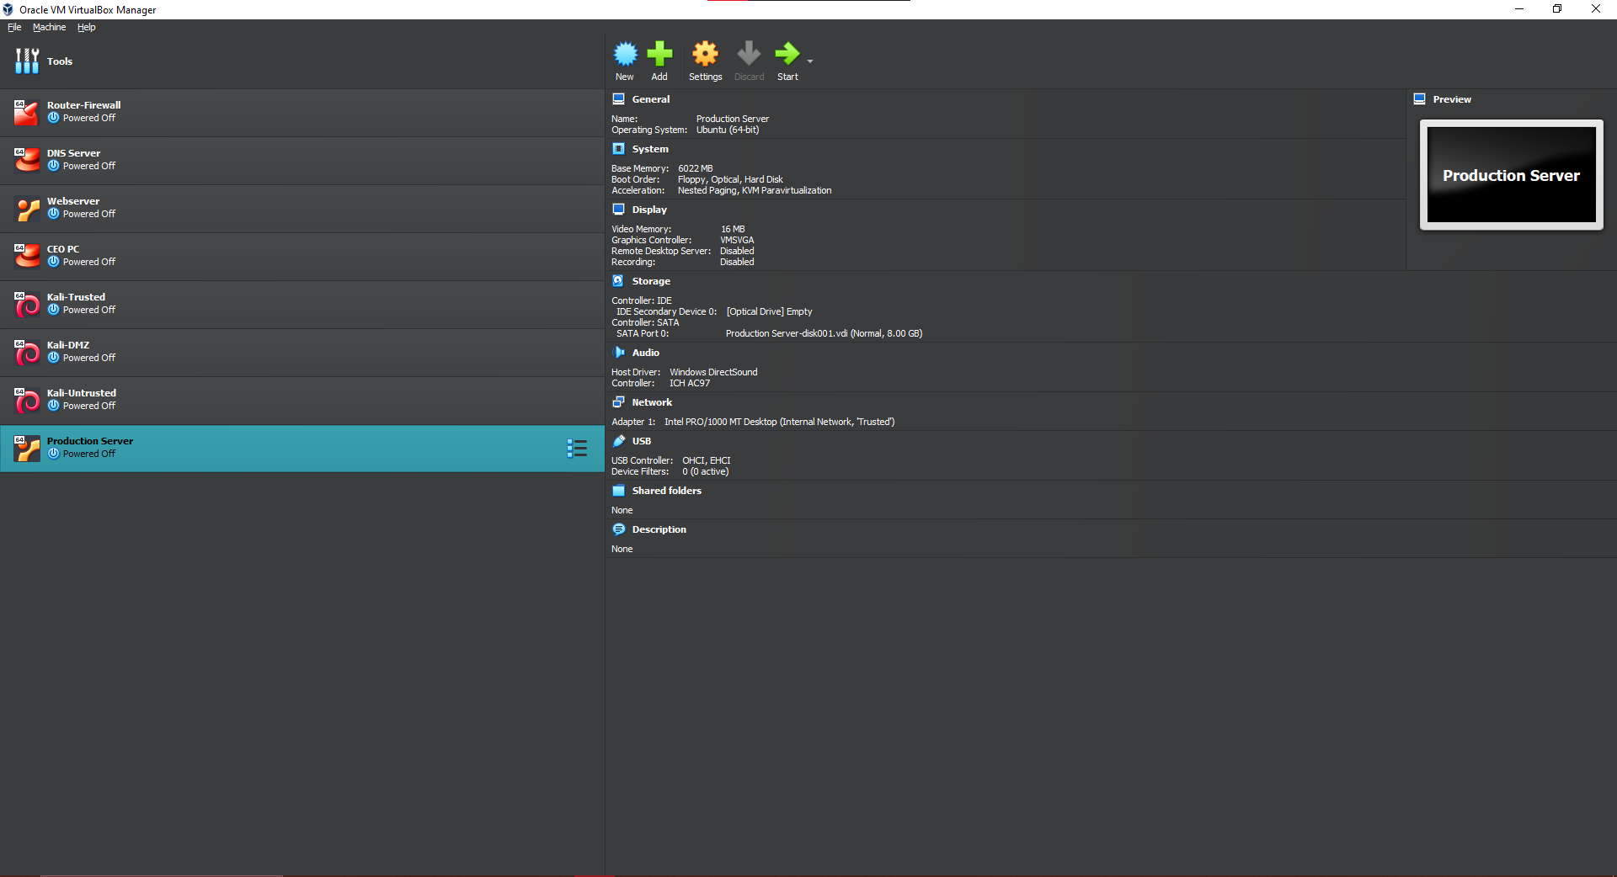
Install of Production Server
Installed the supplied Production server VM into the Trusted network in VirtualBox

Slide 5
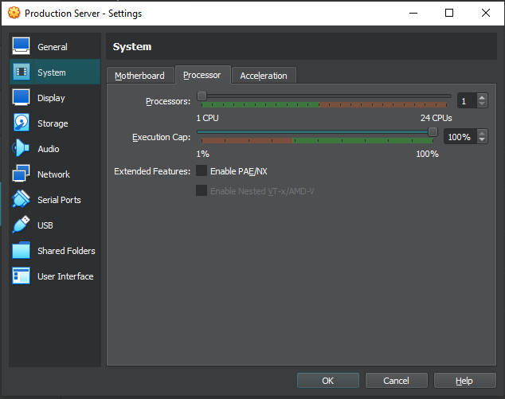
Processor dropped to 1
Changed processor settings to achieve proper performance
Production Server and Webserver wouldn’t run otherwise

Slide 6
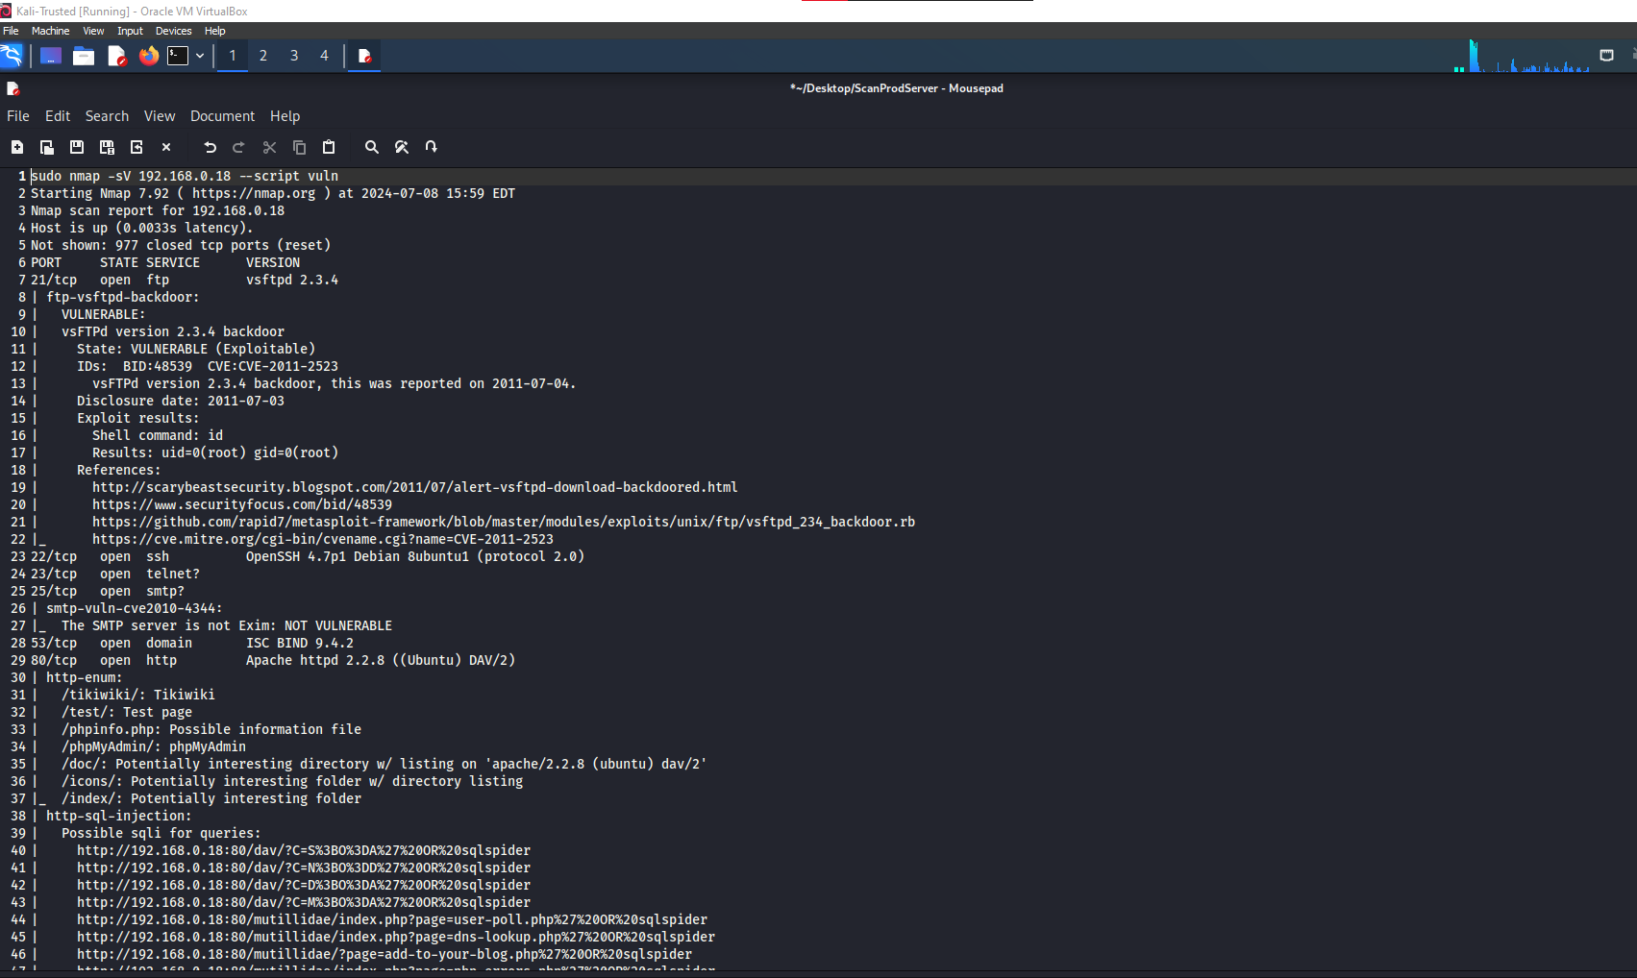
Vulnerabilities of Production Server
Used nmap –sV (ip address) --script vuln

Slide 7
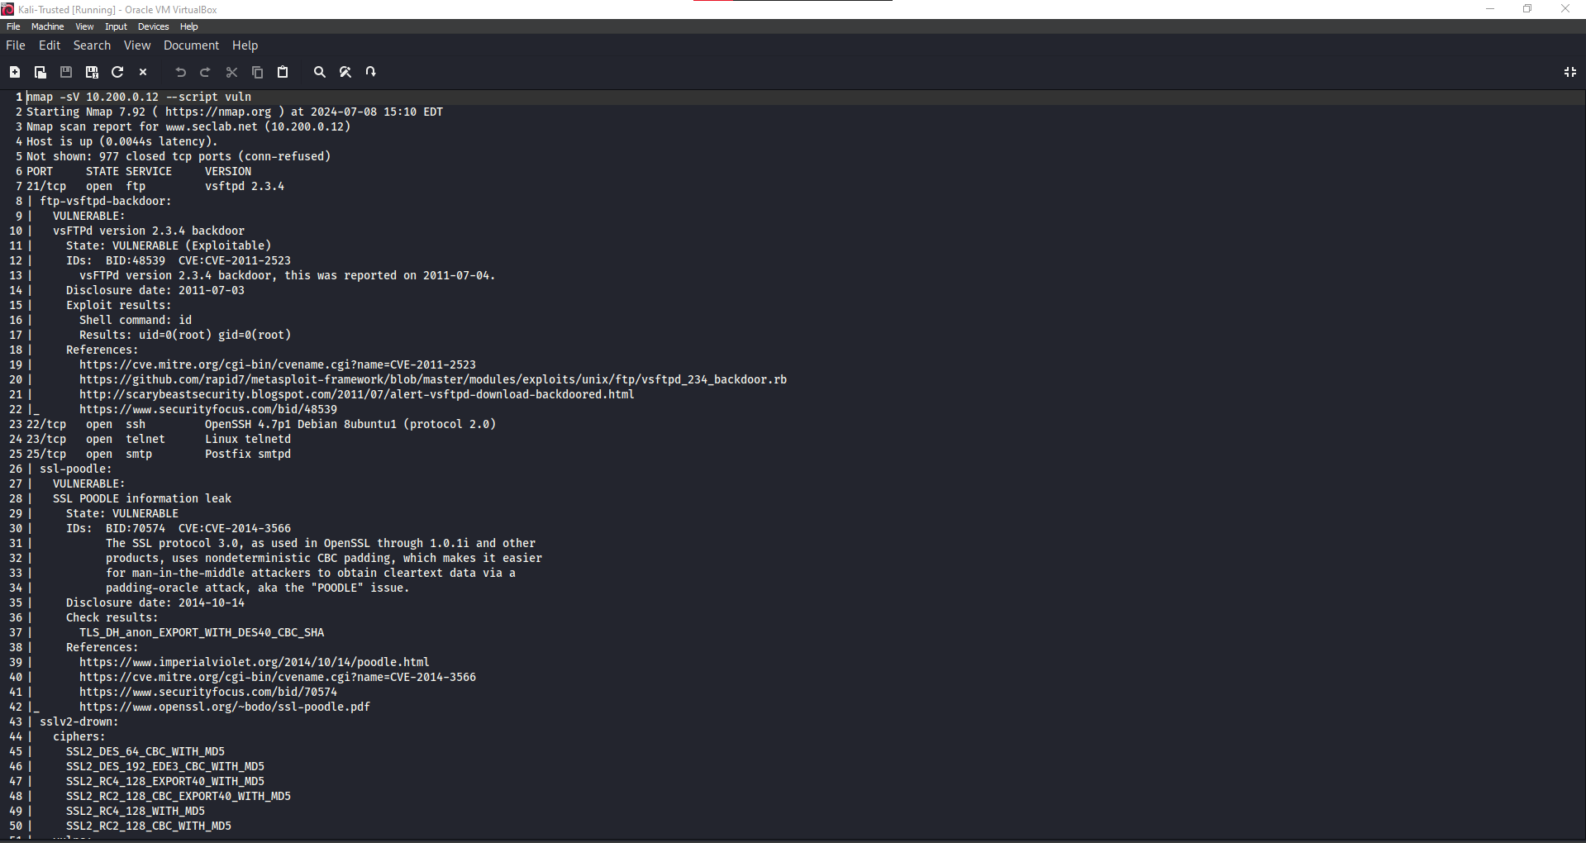
Vulnerabilities of Web Server
Used nmap –sV (ip address) --script vuln

Slide 8
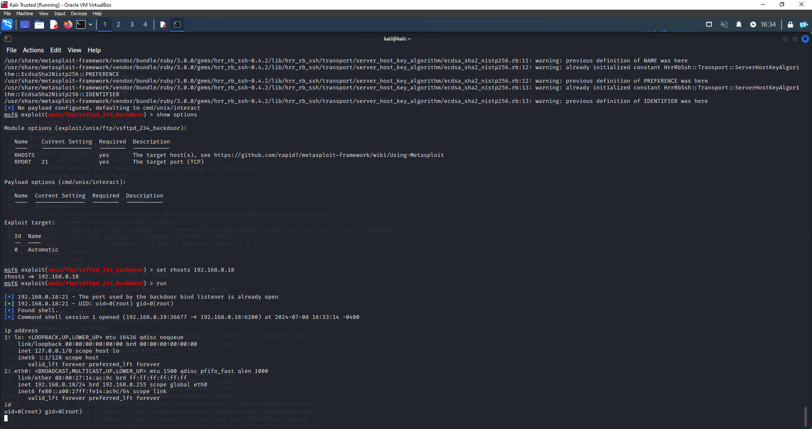
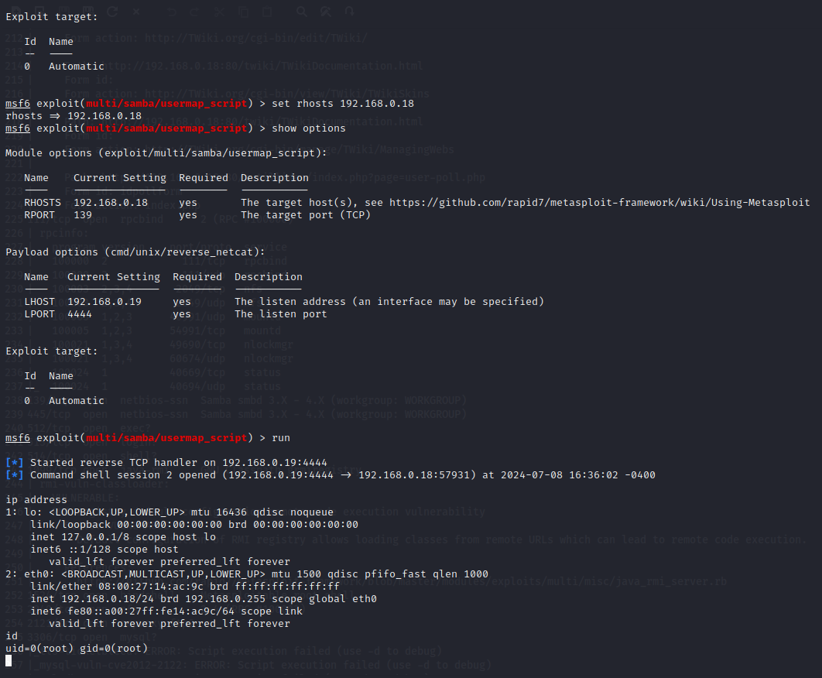
Exploit of Production Server
Utilized metasploitable to exploit the Production Server using vsftpd and Samba gaining root access

Slide 9
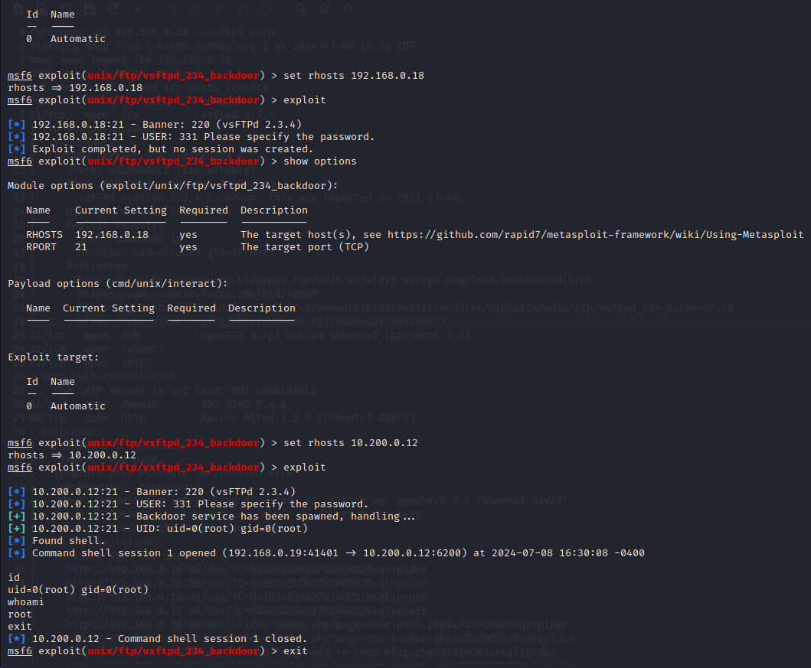
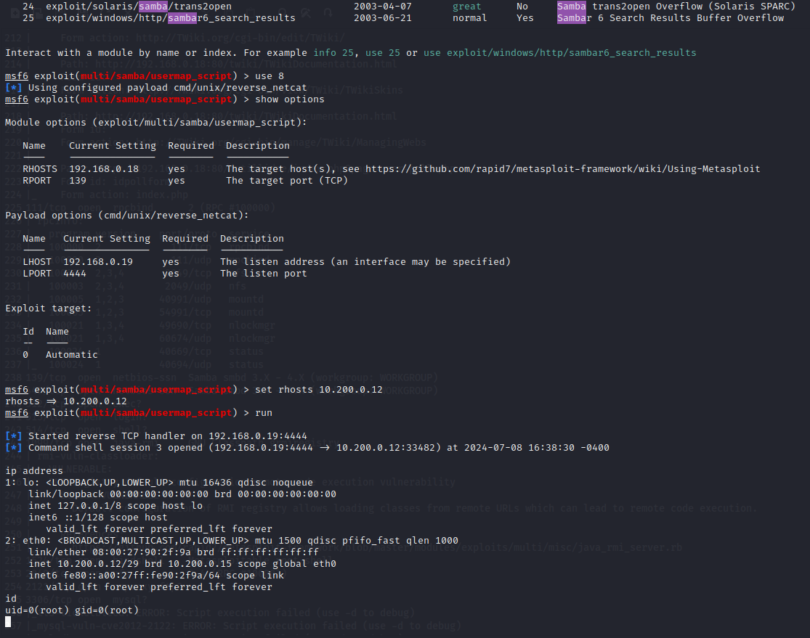
Exploit of Web Server
Utilized metasploitable to exploit the Web Server using vsftpd and Samba gaining root access

Slide 10
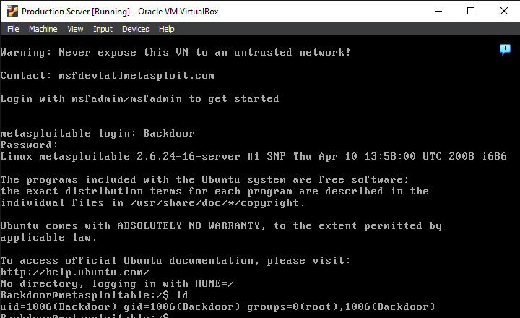
Backdoor Account on Production server with root permissions

Slide 11
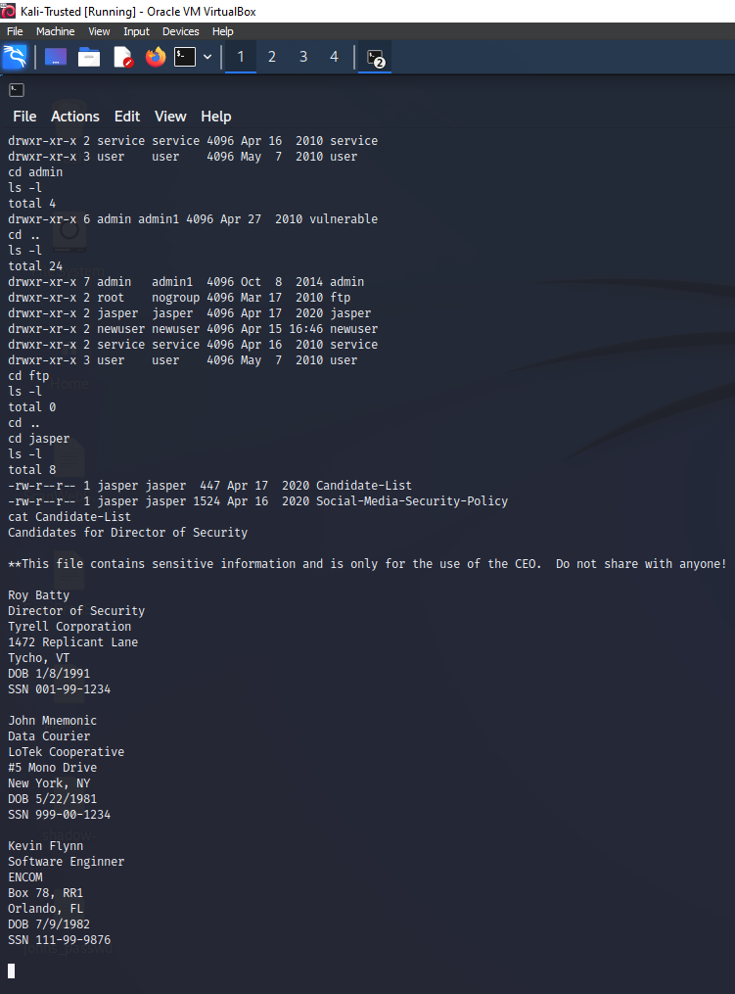
Candidate List
Navigated through directory using:
cd
ls –l
cat

Slide 12
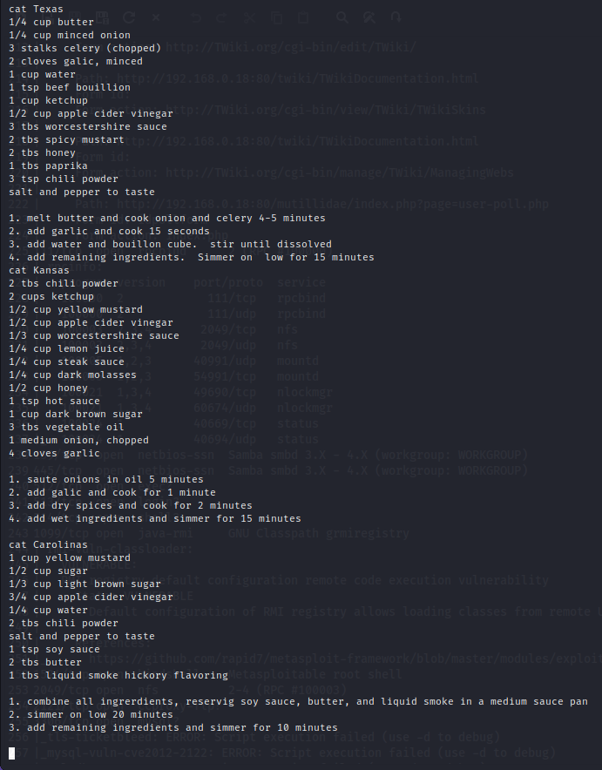
Secret Recipes
Read files with:
cat
Discovered Texas, Kansas, and Carolinas

Slide 13
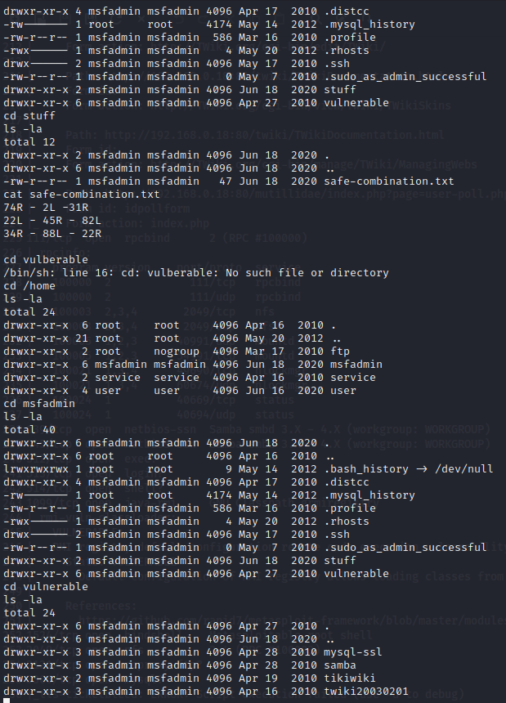
Stuff and Vulnerable
Navigated through directory using:
cd
ls –l
cat
Found safe combination and list of vulnerabilities

Slide 14
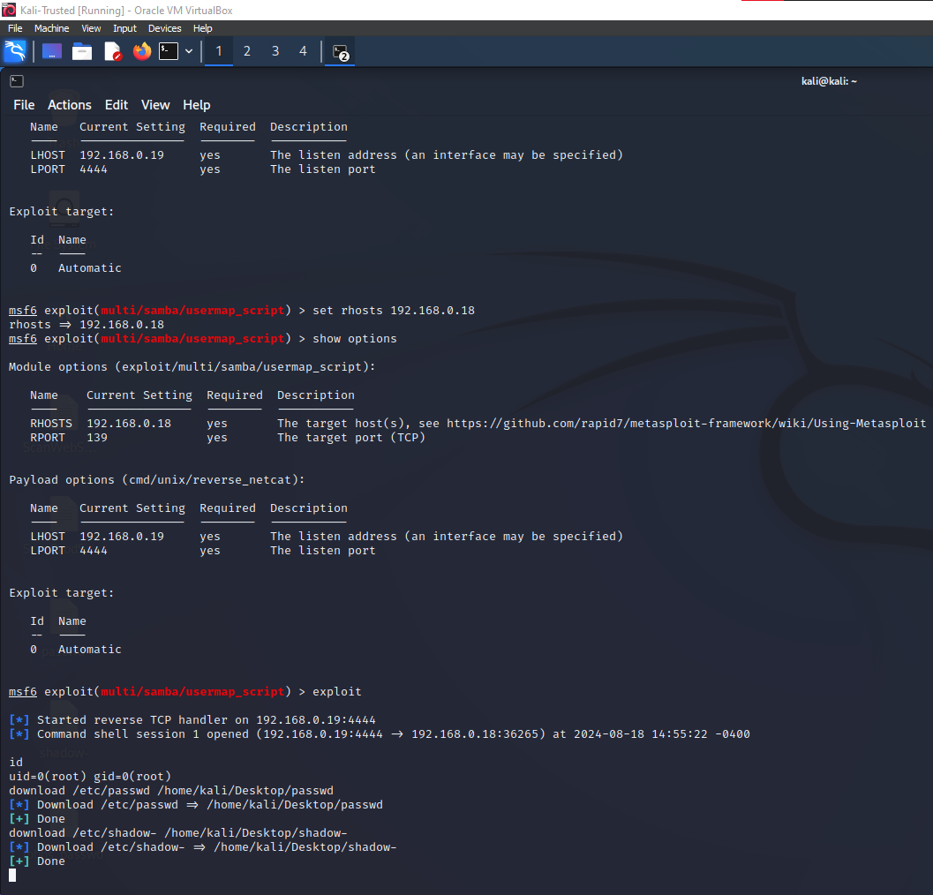
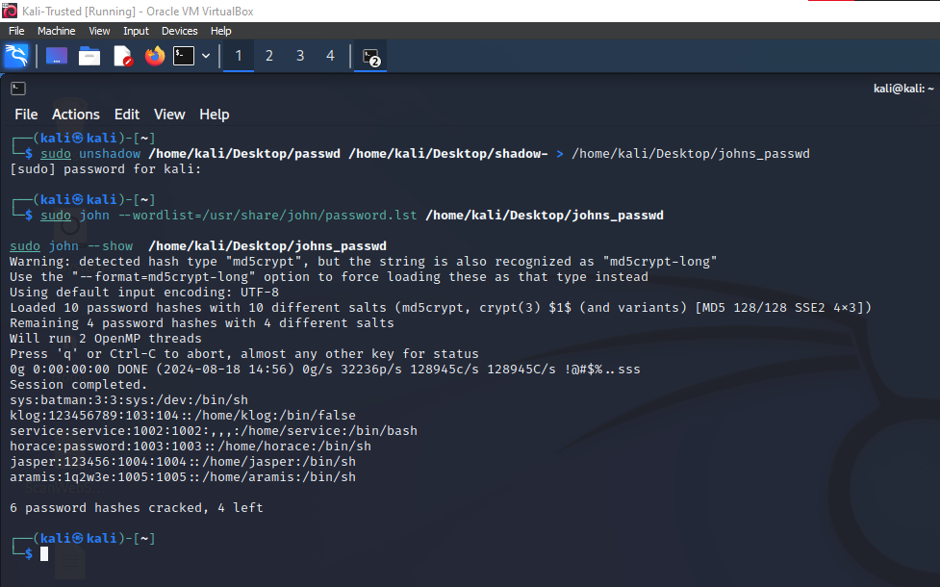
Bonus: Passwords
Downloaded files passwd and shadow- and cracked with following commands

Slide 15
Security Recommendations
Update and Patch Software
Disable Unnecessary Services
Harden Configuration
Firewall and Network Segmentation
Implement Intrusion Detection/Prevention Systems (IDS/IPS)
Restrict Access

